Slide 1
UNIVERSITY OF HARGEISA
Course: Computer Programming I (Java)
Lecture Four
Presented by:
Sahardiid Ahmed Ali

Slide 2
Chapter 3
Numerical Expression

Slide 3
Learning Objectives
At the end of the lesson student should be able to:-
Define Type Casting
Compare Types of Type Casting
Explain Arithmetic Operators
Describe Increment and Descrement Operators
Apply Precedence Rules
Describe Compound Assignment Operators

Slide 4
Type Casting
In Java and in most programming languages a type cast changes the data type of a value from its normal type to some other type.
For example, changing the type of the value 2.0 from double to int involves a type cast.
Define Type Casting?
Type Casting is a method or process that converts a data type into another data type in both ways manually and automatically.

Slide 5
There are Two Types of Type Casting:-
Widening Casting (automatically) - converting a smaller type to a larger type size
byte -> short -> char -> int -> long -> float -> double
Narrowing Casting (manually) - converting a larger type to a smaller size type
double -> float -> long -> int -> char -> short -> byte

Slide 6
Example : Widening Casting
package ict;
public class ICT {
public static void main(String[] args) {
int x = 9;
double y = x; // Automatic casting: int to double
System.out.println(x); // Outputs 9
System.out.println(y); // Outputs 9.0
}
}

Slide 7
Example : Narrowing Casting
package ict;
public class ICT {
public static void main(String[] args) {
double myDouble = 9.78;
int myInt = (int) myDouble; // Manual casting: double to int
System.out.println(myDouble); // Outputs 9.78
System.out.println(myInt); // Outputs 9
}
}

Slide 8
Arithmetic Operators
Java can perform arithmetic calculations which Summarizes the Arithmetic Operators.
Note:-
The use of various special symbols not used in algebra.
The asterisk (*) indicates multiplication; the percent sign (%) is the remainder operator and forward Slash (/) indicates division.

Slide 9
Arithmetic Operators
An arithmetic expression combines operands, operators, and parentheses.
Operands in an arithmetic expression can have mixed data types.
Integer division truncates the result.
The % operator gets the remainder after division.
Arithmetic operator is the remainder operator, or modulus operator, denoted by %.

Slide 10
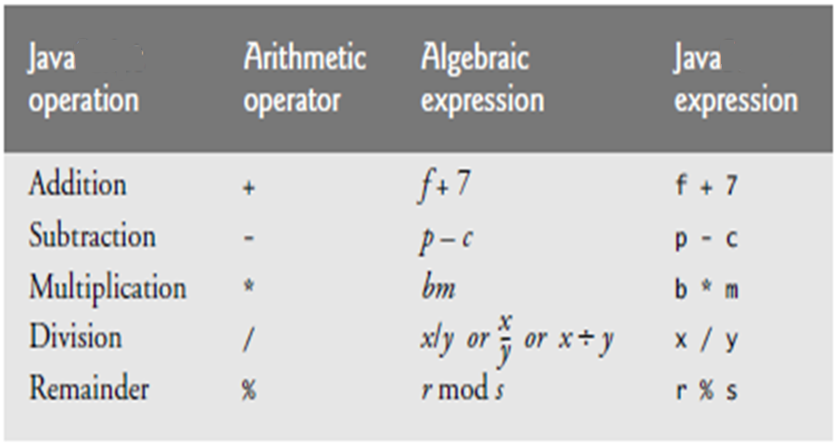
Arithmetic Operators.

Slide 11
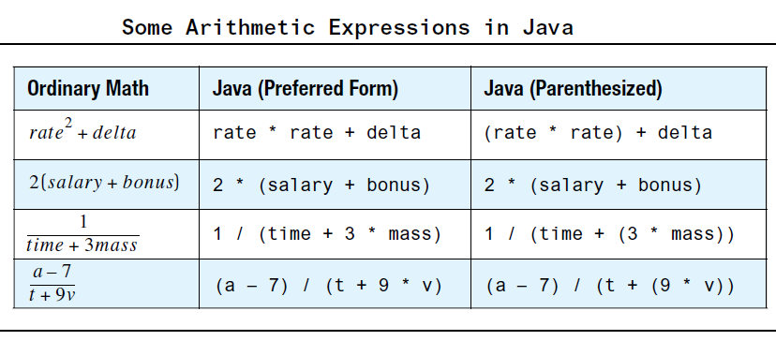

Slide 12
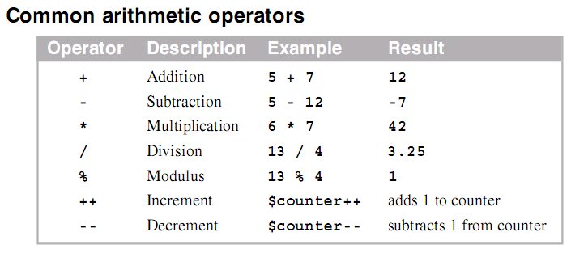
Arithmetic Operators.

Slide 13


A unary operator is an operator that has only one operand (one thing that it applies to), such as the operator 2 in the assignment statement.
Example:
A binary operator has two operands, such as the operators 1 and * in.
Example:

Slide 14
Example : Addition
package ict;
import java.util.Scanner;
public class ICT {
public static void main(String[] args) {
Scanner input = new Scanner (System.in);
System.out.print("Enter the first number: ");
int num1 = input.nextInt();
System.out.print("Enter the second number: ");
int num2 = input.nextInt();
int sum = num1 + num2;
System.out.println();
System.out.println("Sum: "+sum);
}
}

Slide 15
Example : Subtraction
package ict;
import java.util.Scanner;
public class ICT {
public static void main(String[] args) {
Scanner input = new Scanner (System.in);
System.out.print("Enter the first number: ");
int num1 = input.nextInt();
System.out.print("Enter the second number: ");
int num2 = input.nextInt();
int sub = num1 - num2;
System.out.println();
System.out.println("Sub: "+sub);
}
}

Slide 16
Example : Multiplication
package ict;
import java.util.Scanner;
public class ICT {
public static void main(String[] args) {
Scanner input = new Scanner (System.in);
System.out.print("Enter the first number: ");
int num1 = input.nextInt();
System.out.print("Enter the second number: ");
int num2 = input.nextInt();
int mult = num1 * num2;
System.out.println();
System.out.println("multiplication: "+mult);
}
}

Slide 17
Example : Division
package ict;
import java.util.Scanner;
public class ICT {
public static void main(String[] args) {
Scanner input = new Scanner (System.in);
System.out.print("Enter the first number: ");
int num1 = input.nextInt();
System.out.print("Enter the second number: ");
int num2 = input.nextInt();
int div = num1 / num2;
System.out.println();
System.out.println("Division: "+div);
}
}

Slide 18
Example : Remainder
package ict;
import java.util.Scanner;
public class ICT {
public static void main(String[] args) {
Scanner input = new Scanner (System.in);
System.out.print("Enter the first number: ");
int num1 = input.nextInt();
System.out.print("Enter the second number: ");
int num2 = input.nextInt();
int mod = num1 % num2;
System.out.println();
System.out.println("Remainder: "+mod);
}
}

Slide 19
Increment (++) and Decrement (--)
Increment unary operator increases the value of the variable by one .
Decrement unary operator decreases the value of the variable by one.

Slide 20
Example : Increment (++)
package ict;
public class ICT {
public static void main(String[] args) {
int x=4;
x++;
System.out.println("Increment of x: "+x);
}
}

Slide 21
Example : Decrement (--)
package ict;
public class ICT {
public static void main(String[] args) {
int x=4;
x--;
System.out.println("Decrement of x: "+x);
}
}

Slide 22
Parentheses and Precedence Rules
Parentheses can be used to group items in an arithmetic expression in the same way that you use parentheses in algebra and arithmetic.
For example, consider the following two expressions that differ only in the positioning of their parentheses:
(cost + tax) * discount
cost + (tax * discount)

Slide 23
Precedence Rules
Precedence rules and parentheses determine the order of Operations.
Highest Precedence to Lowest Precedence
Parentheses ()
Multiplication *
Division /
Addition +
Subsraction -

Slide 24
Precedence Example
Write java program which uses the following equations
Considering precedence rules:-
EQ1=a * ( b + c )
EQ2=a*b+c

Slide 25
Example : Precedence
package g;
import java.util.Scanner;
public class G {
public static void main(String[] args) {
int eq1;
int eq2;
int a,b,c;
System.out.println("Enter the value of a");
Scanner y=new Scanner(System.in);
a=y.nextInt();
System.out.println("Enter the value of b");
Scanner k=new Scanner(System.in);
b=k.nextInt();
System.out.println("Enter the value of c");
Scanner t=new Scanner(System.in);
c=t.nextInt();
eq1=a*(b+c);
eq2=a*b+c;
System.out.println("The result of equation 1= "+eq1);
System.out.println("The result of equation 2= "+eq2);
}
}

Slide 26
Compound Assignment Operators
A compound assignment operator is an operator that performs a calculation and an assignment at the same time.
All of Java’s binary arithmetic operators (that is, the ones that work on two operands) have equivalent compound assignment operators.
Example:-
a += 10;
is equivalent to
a = a + 10;

Slide 27
Example : Compound Assignment Operators
package v;
public class V {
public static void main(String[] args) {
int b = 120;
b += 10;
int b1 = 20;
b1 -= 10;
int b2 = 30;
b2*= 3;
int b3=40;
b2/=4;
int b4=12;
b4%=3;
System.out.println("Compound Addition= "+b);
System.out.println("Compound Subtraction= "+b1);
System.out.println("Compound Multiplication= "+b2);
System.out.println("Compound Division= "+b3);
System.out.println("Compound Modulus= "+b4);
}
}

Slide 28

Any Question??

Slide 29
Thanks

